Slide 1
Introduction to Digital Forensics
Digital Forensics, Day 1

Slide 2
Class Objectives
By the end of class today, students will be able to:
Summarize the basic principles and methodologies of digital forensics.
Describe various types of jobs and skill sets needed for digital forensics.
Outline the proper way to collect, preserve, analyze, and report.
Demonstrate how to conduct a preliminary review of a forensics case.
Demonstrate preserving and documenting evidence using Autopsy 4.0.

Slide 3
Introduction to
Digital Forensics

Slide 4

Digital forensics is the process of using scientific procedure to collect, analyze, and present evidence of digital devices, usually in relation to criminal investigations.

Slide 5
Digital Forensics and the Chain of Custody
The goal of digital forensics is to present evidence that can be used in a court of law.
A chain of custody assures integrity and accountability of the investigation by
Documenting every step of the investigation.
Showing uninterrupted control.
Ensuring evidence is not tampered with or contaminated.
Defense attorneys will look for mistakes in the chain of custody form to render the evidence inadmissible.

Slide 6
National Initiative for Cybersecurity Education (NICE)
Explore the NICE site and check out some jobs for these various speciality areas:
Analyze
Collect and Operate
Investigate
Performs highly specialized review and evaluation of incoming cybersecurity information to determine its usefulness for intelligence.
Provides specialized denial and deception operations and collection of cyber information used to develop intelligence.
Investigates cybersecurity events or crimes related to IT systems, networks, and digital evidence.
1
2
3
Operate and Maintain
Oversee and Govern
Protect and Defend
Provides support, administration, and maintenance to ensure effective and efficient IT system performance and security.
Provides leadership, management, direction, or development advocacy so the organization can effectively operate.
Identifies, analyzes, and mitigates threats to internal IT systems and networks.
4
5
6
Securely Provision
Conceptualizes, designs, procures, and builds secure IT systems with responsibility for aspects of systems and network development.
7
Source: https://niccs.us-cert.gov/workforce-development/cyber-security-workforce-framework

Slide 7
National Initiative for Cybersecurity Careers and Studies (NICCS)
THe NICCS site provides resources for determining the knowledge, skills, and abilities (KSAs) of digital forensics positions
Check out some of the KSAs for Cyber Defense Forensics Analysts on the NICCS page:
Abilities
Knowledge
Skills
Tasks
Capability Indicators
1
2
3
4
5
Source: https://niccs.us-cert.gov/workforce-development/cyber-security-workforce-framework/digital-forensics

Slide 8
Digital Forensics Types

Slide 9


Types of Digital Forensics
Type | Skills/Knowledge | More Info / Examples
Disk forensics involves acquiring and analyzing information on physical storage media. | Requires extensive knowledge of hardware’s inner workings and the operations of hard drives. | Works with hard drives, smart phones, GPS systems, and removable media.
Memory forensics inspects a computer’s memory to identify activities on a system. | High skill set: You must have knowledge of CPU architectures, operating systems and memory management, page tables and virtual addressing | An attacker will attempt to leave as little evidence on storage media as possible. Your goal is to find that evidence.
Network forensics examines network traffic. | Excellent understanding of communication and network protocols and the tools needed to capture and analyze data. | Works with transaction logs and real-time monitoring.
Email forensics analyzes the source and content of emails. | Identify the sender, recipient, date, time, and origination location of an email. | Can you think of an email forensics case that consumed the headlines a few years ago?
Mobile forensics captures and analyzes the contents of cell phones and smartphones. | Knowledge of mobile device hardware; ability to analyze what is happening on a phone at the time of an incident. | In distracted driving cases, forensics experts can determine what happened at the time of the accident. Don’t text and drive!

Slide 10

Forensics Types
There are many other forensics areas, such as:
Software
Internet
Malware
Drone
Cloud forensics, which poses unique challenges. (see the next activity)

Slide 11
Activity: Digital Forensics in the Cloud
In this activity, you will read about a case concerning a Denial of Service Attack (DoS) at a shopping website.
Then you will compare cloud forensics to other forensic areas and provide two examples of how to maintain a chain of custody in the cloud.
Instructions sent via Slack.
20 minutes

Slide 12
Digital Forensics in the Cloud

Slide 13
Review: Digital Forensics in the Cloud
List at least four components that make digital forensics in the cloud different than other forensics areas:

Slide 14
Review: Digital Forensics in the Cloud
List at least four components that make digital forensics in the cloud different than other forensics areas:
There is no physical access to the computer where the crime took place.
If the crime takes place on a cloud server, a malicious user can claim that everyone in the world with internet access should be a suspect.
When the crime takes place on a cloud server, it's difficult to pinpoint where their data ends and where another company, that police do not have a warrant for, begins.

Slide 15
Review: Digital Forensics in the Cloud
List at least four components that make digital forensics in the cloud different than other forensics areas:
Because many people will often use the same cloud server, there are SLA's that have to be recognized when dealing with other companies.
Volatile memory, such as RAM, would be lost if the cloud server is rebooted.
It would be difficult to trace which cloud server is storing the users data.

Slide 16
Review: Digital Forensics in the Cloud
How do these differences affect the chain of custody?

Slide 17
Review: Digital Forensics in the Cloud
How do these differences affect the chain of custody?
It is difficult to pinpoint where and which cloud server has been compromised.
This would also present the problem of the cloud server being in another county’s jurisdiction.

Slide 18
Review: Digital Forensics in the Cloud
Challenges of Maintaining a Chain of Custody in Cloud Forensics
No Physical Access
The exact location of where the data may not be known.
Preserving the evidence
Isolating and securing the evidence is challenging when data is located in multiple locations.
Data Integrity
Evidence may be captures live and the evidence can be altered if not collected correctly.

Slide 19
Methodology for Conducting
an Investigation

Slide 20
Investigation Methodology
Collection
Preserving Evidence
Analysis
Reporting
The National Institute of Standards and Technology provides one of many frameworks for forensic investigation phases.
In preparation, an investigator needs to consider:
Is this incident remote or local?
What laws are relevant?
What tools should be used (GUI or CLI)?

Slide 21
Collecting Evidence
Collection
Preserving Evidence
Analysis
Reporting
The success of the investigation relies on the collection phase.
During this phase, an investigator makes decisions about what data to collect and the best way to collect it.
Evidence is extracted from a device and a master copy is made.
How you collect the evidence determines whether it will be admissible in court.

Slide 22
Preserving Evidence
Collection
Preserving Evidence
Analysis
Reporting
Investigators never work with the original copy of evidence.
Instead, a read-only master copy is made and stored in a digital vault. Then, all the processes are worked on the copy.
A cryptographic digest is made to ensure that evidence has not been altered in any way.

Slide 23
Electronic Discovery and Analysis
Collection
Preserving Evidence
Analysis
Reporting
Analysis is completed after data is collected. This process is also known as dead analysis.
Investigators document everything, including time, dates, applications used, etc.
If your evidence cannot be reproduced, it may be ruled as inadmissible in court.

Slide 24
Presenting and Reporting
Collection
Preserving Evidence
Analysis
Reporting
Investigators write an expert report that explains:
What tests were conducted
When, how, and what was found
The conclusions of the investigation
Digital forensics analysts may testify as expert witnesses in a trial or deposition.

Slide 25
2012 National Gallery Case

Slide 26

The 2012 National Gallery Case
Over the next two days, we’ll work on a real-life case.
The case involves an art theft and defacement at the National Gallery in Washington D.C.
Law enforcement seized electronic devices from an employee after suspicious activity was reported.
The evidence was processed by the Crime Laboratory ingest team and backed up using Encase.

Slide 27
Activity: 2012 Nat’l Gallery Case
In this activity, you will be acting as novice investigators working for the We-Carve-4-U digital forensics company. Your supervisor has given you a training case to prepare for field work. The seized evidence has been processed by the ingest team at the Crime Laboratory.
Instructions sent via Slack.
20 minutes

Slide 28
2012 National Gallery Case

Slide 29
2012 National Gallery Case Review
What is the case?
Who are the suspects?
What evidence was confiscated?
What could be admissible as evidence.

Slide 30
National Gallery Case Evidence

Slide 31

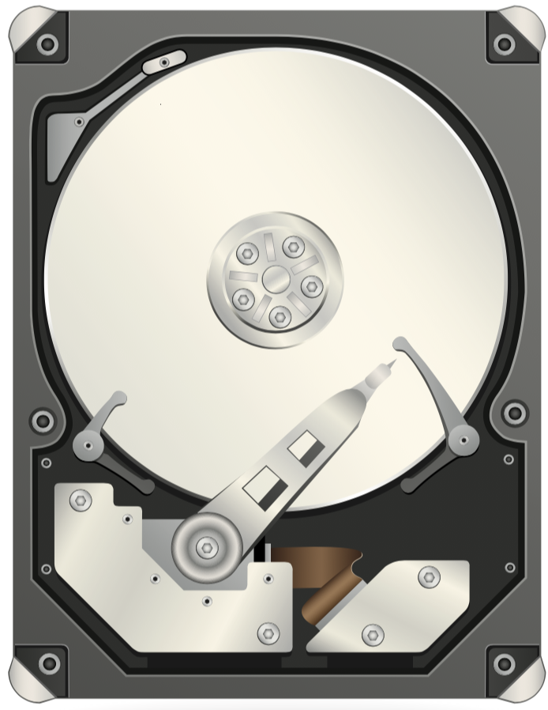
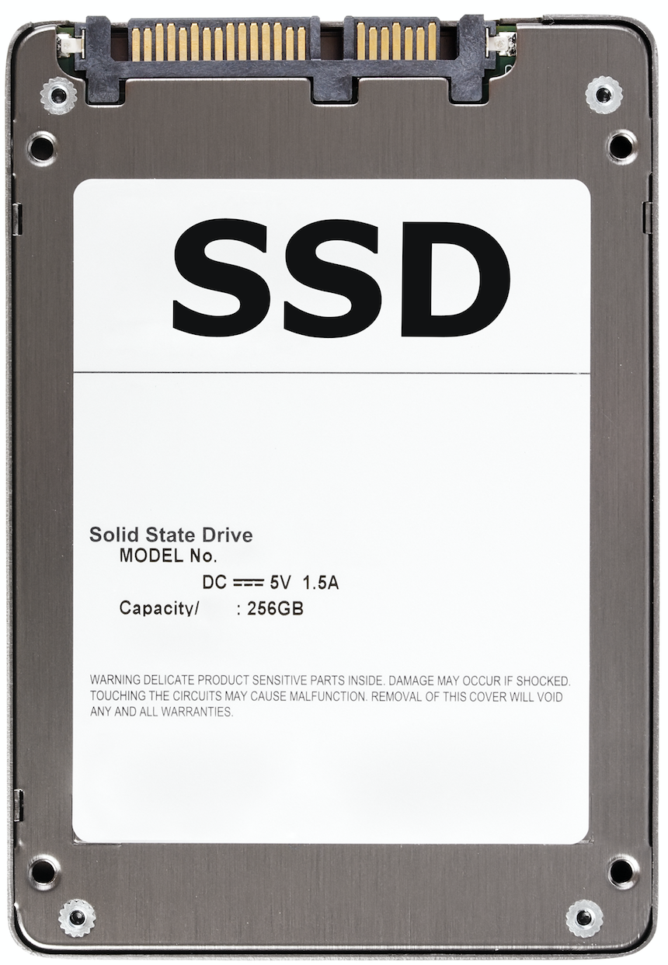
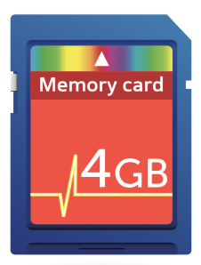
Storage Media Overview
The various storage devices you’ll encounter hold content such as operating and file system data, applications, documents, pictures, videos, and music.
 | Optical devices such as CD ROMS, DVDs, and Blu-Ray are used for mobile storage. They hold from 700 MB to 50 GB of data.
 | Hard Disk Drives (HDD) are used in computer devices and store up to 16 terabytes of data.
 | Solid State Drives (SSD) can store up to 16 terabytes of data.
 | SD cards are used in smartphones like Android and store up to 521 GB of data.
Notes:
Icons Shutterstock ID: 80749834

Slide 32
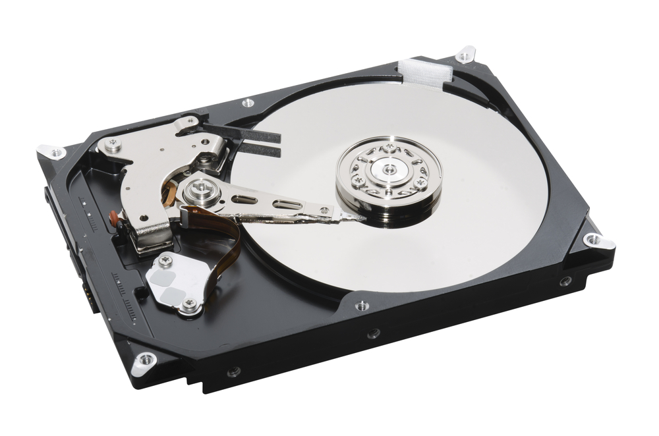

Hard Drives
Hard drives are made up of an actuator, an actuator arm, a platter, and a spindle.
Data is read and written by the actuator arm and attached head moving over the spinning platter.
Data is stored in a series of concentric circles called tracks, which are then divided into sectors.
Information about free and used sectors are stored in the file allocation table (FAT).
Actuator Arm
Platter
Actuator
Spindle
Implication for forensics: A solid knowledge of the inner workings of hard drives lets you recover data from badly damaged devices.
Notes:
Shutterstock ID: 131019800

Slide 33
A Closer Look at Storage Media
Flash Storage Memory | Solid State Drives (SSD) | SD / MicroSD Cards
Hard drives are limited by the speed at which they send and receive information. Flash storage devices use flash memory to quickly access data. Holds data without external power source . Non-volatile storage found in USB drives, mobile phones, cameras, and tablets. | Use flash memory chips. Not a mechanical device. Forensic Implication: SSD data can be lost or wiped out within seconds, so be careful when using forensic tools to image and recover data. | SD cards store data in a flash memory chip similar to solid state devices. Used in cell phones and smartphones. Forensic Implication: It is possible to retrieve SD card data even if it has been deleted or the disk has been formatted. Rather than being erased, data is set aside for reuse.

Slide 34
File Systems
During an investigation, you might encounter these file systems:
New Technology File System (NTFS), supported by Windows 10, 8, 7, Vista, XP, and NT
File Allocation System (FAT), supported by older and newer versions of Windows
Apple File System (AFS), used by the Mac OS system
Fourth Extended File System (Ext4), used in RedHat, Kali, and Ubuntu

Slide 35
How Evidence Was Obtained: Disk Forensic Image
In the Gallery Case, evidence was gathered from an iPhone and saved in the Encase Eyewitness Format (*.E01) as a disk forensic image (a copy image of data that is analyzed).
Acquiring data from an image involves a bit-level-copy of the entire physical data source.
Cluster
File: example.doc
A
B
C
D
E
G
H
I
J
L
N
2048 byte
2048 byte
2048 byte
2048 byte
Deleted file: example.doc
A
B
C
D
E
G
H
I
J
L
N
Free Space
Overwritten file
Slack Space
New File
G
H
Free Space
Notes:
Recreated diagram

Slide 36
How Evidence Was Obtained: Disk Forensic Image
A basic file system copy is inadequate for forensic analysis. If you do a copy through the file or operating system, you can see only the data that the operating system sees. It will not capture deleted files or slack space. You need to obtain a bit-level copy.
Cluster
File: example.doc
A
B
C
D
E
G
H
I
J
L
N
2048 byte
2048 byte
2048 byte
2048 byte
Deleted file: example.doc
A
B
C
D
E
G
H
I
J
L
N
Free Space
Overwritten file
Slack Space
New File
G
H
Free Space
Notes:
Recreated diagram

Slide 37
Forensic Disk Image Formats
Raw Format | Advanced Forensic Format (AFF)
Created with programs like dd, ddfldd, and ddcdd.) | For disk image and related forensic metadata.
Examples: .bin .dd .img .raw | Examples: .AFF .AFF4

Slide 39
Introduction to Autopsy

Slide 40
Autopsy
Now we’ll look at the software used to analyze the image file.
We will use Sleuthkit Autopsy, an open source, graphical tool that runs on Windows, Ubuntu, Kali, and OSX.
First we’ll prepare the data by:
Running a virus scan on the image.
Generating an md5 and sha256 hash for the evidence. (To validate that nothing was changed during the investigation.)
Open a terminal window in Kali and navigate to the Evidence directory
Run md5sum tracy-phone-2012-07-15.final.E01 > tracy.original.md5log.txt
Run sha256sum tracy-phone-2012-07-15.final.E01 > tracy.original.sha256log.txt

Slide 41
The Autopsy Workflow
Create a case
Case name, investigator information, and optional information
Add an Image
Autopsy supports Raw, Encase, and Virtual Disk image formats.
Configure ingest modules
For example: Email Parser, Embedded File Extractor, Android Analyzer
Ingest in progress
A time consuming process
Manual Analysis
Analysing data
Create timeline
Time, data, and data source
Report
Format (HTML, Excel)

Slide 42
How to Create a Case

Slide 43
Activity: Introduction to Autopsy
In this activity, you will load evidence into Autopsy for analysis. Please follow the directions in the checklist.
Instructions sent via Slack.
15 minutes

Slide 44
Activity: Introduction to Autopsy
Suggested Time: 15 minutes
Below is a breakdown of the steps you will take. Please refer to the slacked out file from detailed instructions.
Pre-Step 1: Prepare the Data
Pre-Step 2: Getting Started: Creating a Case
Step 1: Set Up Case Information + Optional Information
Step 2: Select Types of Data
Step 3: Configure Ingest Modules (Hash Data Sets + Additional Ingest Settings)
Step 4: View Output from Autopsy

Slide 45
Introduction to Autopsy

Slide 46
Class Objectives
By the end of class today, students will be able to:
Summarize the basic principles and methodologies of digital forensics.
Describe various types of jobs and skill sets needed for digital forensics.
Outline the proper way to collect, preserve, analyze, and report.
Demonstrate how to conduct a preliminary review of a forensics case.
Demonstrate preserving and documenting evidence using Autopsy 4.0.

